Slide 1

ZEROTH REVIEW DDoS Protection System for Cloud: Architecture and Tool Project Category : RESEARCH
Supervisor Name Dr. Balaji Srikaanth P, AP/NWC Dr. S. Nagendra Prabhu, AP/CINTEL | Batch No. NW000156 Shaurya Singh Srinet – RA2111032010006 Shounak Chandra – RA2111032010026 Charvi Jain – RA2111047010113

Slide 2
Abstract
Increasing cloud adoption heightens the risk of DDoS attacks, threatening service availability and data security.
We propose a scalable DDoS Protection System designed for real-time detection and mitigation in cloud environments.
Utilizes a multi-layered architecture with machine learning to distinguish between malicious and legitimate traffic patterns.
Ensures seamless integration across various cloud platforms while maintaining performance and minimizing false positives.
Aligns with industry security standards to safeguard data integrity and service continuity.

Slide 3
Introduction
DDoS attacks pose significant risks to cloud systems, leading to data loss, service disruption, and reputational damage.
As organizations shift to cloud infrastructures, the threat of DDoS attacks becomes more critical.
Traditional security mechanisms often fail to detect and mitigate DDoS threats in real-time.
We propose a cloud-native DDoS Protection System using machine learning for real-time anomaly detection and automated traffic filtering.
The system analyzes traffic patterns and historical data to differentiate between malicious and legitimate requests, ensuring continuous service.
Adaptable to various cloud architectures, it also complies with industry security standards for data integrity and protection.

Slide 4
Introduction
Our solution effectively mitigates DDoS attacks without negatively impacting cloud performance, ensuring business continuity.
The key innovation is combining cloud-native solutions with machine learning models to create a scalable and compliant DDoS defense.
Experimental results show the system can handle attack traffic at volumes of many Mbps while maintaining optimal cloud resource utilization.
There is no impact on service quality or latency, ensuring uninterrupted user experience.
The system adapts over time, continually learning emerging attack patterns through advanced machine learning algorithms.
This ongoing learning improves detection and response capabilities, enhancing the system’s effectiveness over time.

Slide 5
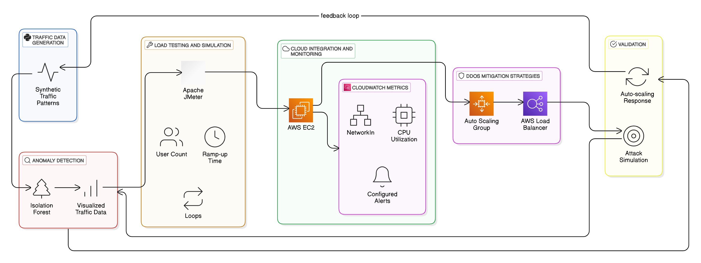
Architecture Diagram

Slide 6
Proposed Method
Data Generation and Anomaly Detection
Traffic Data Generation:
Synthetic traffic data is generated using a Python script to simulate real-world web traffic patterns.
Anomaly Detection:
Implemented using the Isolation Forest algorithm from scikit-learn.
The algorithm identifies anomalies in the traffic data, which may indicate suspicious activity or potential DDoS attempts.
Detected anomalies are plotted using matplotlib for visual analysis.

Slide 7
Proposed Method
2. Load Testing and Traffic Simulation
Load Testing Tool:
Apache JMeter is used to simulate high traffic loads on the system.
Simulation:
Configured to send HTTP requests to the server, mimicking multiple users.
Varying parameters like the number of users, ramp-up period, and loop count to analyze server behavior under stress.
3. Cloud Integration and Monitoring
AWS EC2:
Deployed the anomaly detection scripts and traffic monitoring on an AWS EC2 instance.
CloudWatch Monitoring:
Metrics such as NetworkIn and CPU Utilization are monitored.
Alerts are configured to notify when thresholds are exceeded.

Slide 8
Proposed Method
4. DDoS Mitigation Strategies
Auto-Scaling:
Configured an Auto Scaling Group to dynamically launch or terminate instances based on traffic load.
Load Balancer:
Used an AWS Load Balancer to distribute incoming traffic evenly across instances.
5. Validation
Simulating Attacks:
High traffic simulated through JMeter to simulate DDoS attack scenarios.
Response Analysis:
Verified the system's ability to detect anomalies, scale up/down instances, and maintain system availability during the load test.

